Slide 1
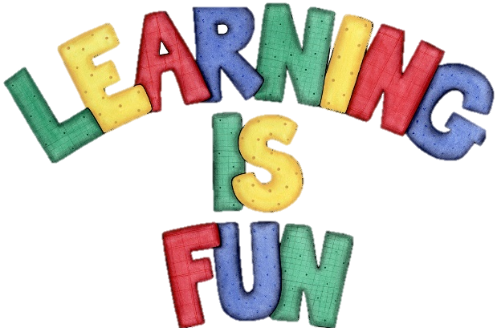
Y11 Induction Day – Computer Science
What will you be doing in this course?
2 years of study
2 final exams + 1 coursework
1 final grade!

Slide 2
Y11 Induction Day – Computer Science
Year 12 – Each week we will cover:
Theory Topic (3 lessons) Practical Programming (2 lessons)
Computational Thinking
Thinking Abstractly
Thinking Ahead
Thinking Procedurally
Thinking Logically + Concurrently
Problem Recognition + Solving
Data Representation
Binary + Hexadecimal
Binary Addition + Shift
Signed Integers + Subtraction
Floating Point Binary
Arithmetic Operations
Characters

Slide 3
Y11 Induction Day – Computer Science
Year 12 – Each week we will cover:
Theory Topic (3 lessons) Practical Programming (2 lessons)
System Architecture
The CPU
CPU Performance + Pipelining
Processor Types + Von Neumann
Input, Output + Storage
System Software
System Software
The Operating System
Assembly Language
Addressing Modes
System Development

Slide 4
Y11 Induction Day – Computer Science
Year 12 – Each week we will cover:
Theory Topic (3 lessons) Practical Programming (2 lessons)
Databases
Structure + Relationships
Normalisation
SQL (Basics)
SQL (Complex)
Transaction Processing
Impacts of Tech
Legislation
Artificial Intelligence
Automated Decision Making
Environmental Issues
Privacy
Thoughtful Design

Slide 5
Y11 Induction Day – Computer Science
Year 13 – Each week we will cover:
Theory Topic (3 lessons) NEA Project (2 lessons)
Algorithms
Recursion
Big-O / Algorithm Efficiency
Search + Sort Algorithms
Graph Traversal
Optimisation Algorithms (Dijkstra)
Optimisation Algorithms (A*)
Data Structures
Queues
Stacks
Lists
Hash Tables
Trees

Slide 6
Y11 Induction Day – Computer Science
Year 13 – Each week we will cover:
Theory Topic (3 lessons) NEA Project (2 lessons)
Networks
Internet Structure
Packet Switching
Security
TCP + Protocols
Web Technologies
Boolean Logic
Logic Gates
Boolean Algebra
Karnaugh Maps

Slide 7
Introduction – What are the expectations?
This is an A Level course
The expectations on behaviour and homework are much higher
than during your GCSE studies
Homework
4 hours a week
Complete lesson tasks
Revise for assessments
Work on NEA
Behaviour
Arrive on time to lessons
Meet all deadlines
Games = Out + Message Home
Swearing = Out + Message Home

Slide 8
Task – Complete the Introduction Quiz
Online quiz
Working individually
Not a test or baseline assessment
Only topics that were covered at GCSE
55 questions – stay focused!
If you finish before the others:
Help the other members of your class – it’s only for fun!
Look through your results to see where you lost points

